Slide 1
Chapter Twenty-Three
Understanding Operational Procedures

Slide 2


220-902 Objectives Covered
5.1 Given a scenario, use appropriate safety procedures.
  Equipment grounding
  Proper component handling and storage
    Antistatic bags
    ESD straps
    ESD mats
    Self-grounding
  Toxic waste handling
    Batteries
    Toner
    CRT
  Personal safety
    Disconnect power before repairing PC.
    Remove jewelry.
    Lifting techniques
    Weight limitations
    Electrical fire safety
    Cable management
    Safety goggles
    Air filter mask
  Compliance with local government regulations
5.2 Given a scenario with potential environmental impacts, apply the appropriate controls.
  MSDS documentation for handling and disposal
  Temperature, humidity level awareness, and proper ventilation
  Power surges, brownouts, blackouts
    Battery backup
    Surge suppressor
  Protection from airborne particles
    Enclosures
    Air filters/Mask
  Dust and debris
    Compressed air
    Vacuums
  Compliance to local government regulations

Slide 3
220-902 Objectives Covered
5.3 Summarize the process of addressing prohibited content/activity, and explain privacy, licensing, and policy concepts.
Incident response
  First response
    Identify
    Report through proper channels
    Data/device preservation
  Use of documentation/documentation changes
  Chain of custody
    Tracking of evidence/ documenting process
  Licensing / DRM / EULA
    Open source vs. commercial license
    Personal license vs. enterprise licenses
  Personally Identifiable Information
  Follow corporate end-use policies and security best practices
5.4 Demonstrate proper communication techniques and professionalism.
  Use proper language – avoid jargon, acronyms, slang when applicable.
  Maintain a positive attitude / project confidence.
  Actively listen (taking notes) and avoid interrupting the customer.
  Be culturally sensitive.
    Use appropriate professional titles, when applicable.
  Be on time (if late, contact the customer).
  Avoid distractions.
    Personal calls
    Texting / Social media sites
    Talking to co-workers while interacting with customers
    Personal interruptions
  Dealing with difficult customer or situation
    Do not argue with customers and/or be defensive.
      Avoid minimizing customer’s problems.
      Avoid being judgmental.
    Clarify customer statements (ask open-ended questions to narrow the scope of the problem, restate the issue or question to verify understanding).
    Do not disclose experiences via social media outlets.
  Set and meet expectations/timeline and communicate status with the customer.
    Offer different repair/replacement options if applicable.
    Provide proper documentation on the services provided.
    Follow up with customer/user at a later date to verify satisfaction.
  Deal appropriately with customer’’s confidential materials.
    Located on a computer, desktop, printer, etc.

Slide 4
PC Safety Issues
Break them into 4 general areas:
Computer components
Electrostatic discharge
Electromagnetic interference
Natural elements

Slide 5

Components
Power Supply
Monitor
Case
Keyboard/Mouse
Printer
High Voltage Probe=>
Notes:
Power
The two biggest dangers with power supplies are burning or electrocuting yourself – capacitors hold charge even when unplugged. Connect a resistor across the leads of the capacitor to discharge
Monitor
do not try to repair monitors
A+ exam may test your knowledge of the safety practices to use if you ever you need to do so. If you have to open a monitor, you must first discharge the high-voltage charge on it by using a high-voltage
probe. Do not use an ESD strap when discharging the monitor; doing so can lead
to a fatal electric shock
The Case
be careful when handling them.
You can, for example, cut yourself by jamming your fingers between the case and
the frame when you try to force the case back on
Keyboard/Mouse
Keep liquids far
Free the cords
The Printer
Do not turn Toner upside down
Do not put any objects into the feeding system
Do not look directly into the source of the laser
do not try to blow in the ink cartridge to clear a clogged opening
Laser printers use very high voltage power sources
Don’t burn yourself on internal components

Slide 6
Electrostatic Discharge (ESD)
Antistatic Wrist Straps
Touch the chassis/Self grounding
Anti-static bags for parts
ESD Antistatic Mats
Increase Humidity
Notes:
CPU chips and memory chips are particularly sensitive to ESD. Be extremely cautious when handling them
Just by sitting in a chair, you can generate around 100 volts of static electricity
This voltage can occur in any room with very low humidity—like a heated room in wintertime
For an antistatic wrist strap to work properly, the computer must be plugged in but
turned off. When the computer is plugged in, it is grounded through the power cord. When
you attach yourself to it with the wrist strap, you are grounded through the power cord as
well. If the computer is not plugged in, there is no ground and any excess electricity on you
will just discharge into the case, which is not good. Dry air
promotes static electricity
This mat drains excess charge away from any item coming in contact with it (see Figure 23.2).

Slide 7
Electromagnetic Interference (EMI)
also known as radio frequency interference (RFI):
Network devices
Magnets
Cordless phones
Microwave ovens
Notes:
EMI is an unwanted disturbance caused by electromagnetic radiation generated by
another source. In other words, some of your electrical equipment may interfere with other equipment.
Microwaves - The radiation they generate is typically in the 2.45GHz range

Slide 8
Natural Elements
Avoid direct sunlight
Avoid water sources
Avoid Dirt and dust

Slide 9
Creating a Safe Workspace
Moving computer equipment
Using appropriate repair tools
Creating a safe work environment
Implementing safety policies and procedures

Slide 10
Moving Computer Equipment
Unplug it!
Tether power cords.
Remove loose jewelry.
Lift with legs.
Do not twist.
Keep objects close to your body.
Push rather than pull.

Slide 11
Using the Right Repair Tools
PC repair kit
Screwdrivers
Anti-static wrist straps
Other useful tools
  Pliers
  Wire cutters
  Strippers
  Mirrors
  Flashlight
  Compressed air

Slide 12
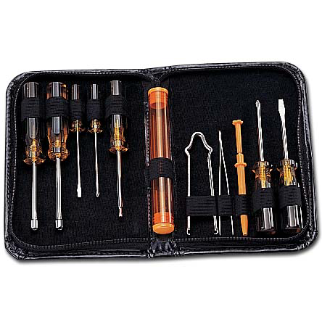
PC Repair Kit

Slide 13
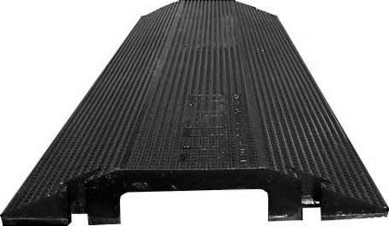

Creating a Safe Environment
Avoid trip hazards.
Floor cable guard
Cable ties

Slide 14
Implement Safety Policies and Procedures
Employer and employee have responsibilities.
Create and train on safety plans.
Define clear policies for incident management.
Notes:
The Occupational Safety and Health Act states that every working American has the right to a safe and healthy work environment.
Occupational Safety and Health Administration (OSHA) was formed to enforce the act. OSHA covers all private-sector employees and post office workers.
Public-sector employees are covered by state programs, and federal employees are covered under a presidential executive order.
There are three overarching criteria to a safe work environment:
■■ The company and its employees have identified all significant hazards in the work setting.
■■ Preventive measures have been taken to address each significant hazard.
■■ The company and its employees understand how to respond to accidents or near-miss accidents if or when they occur.

Slide 15
Handling Accidents
Environmental Accidents (POWER/WATER)
Human Accidents (TRIP/SPILLS)

Slide 16
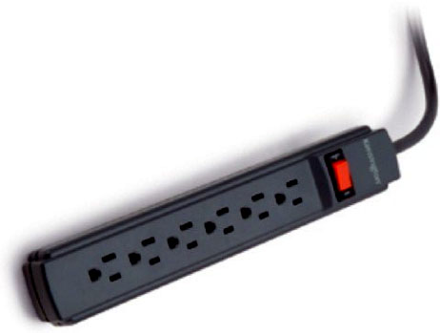
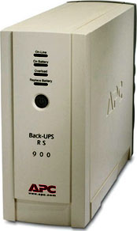
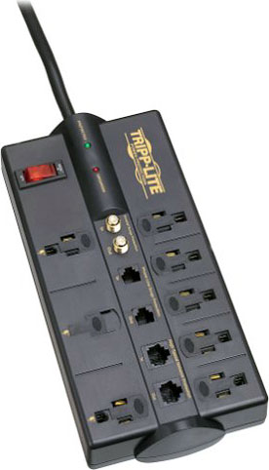
Maintaining Power

Slide 17
Natural Elements
Sunlight
Water
Heat
Dust and dirt
Unreliable power sources

Slide 18
Using Safety Documentation
OSHA (Occupational Safety and Health Administration)
MSDS (Materia Safety Data Sheets)
Notes:
The United States Occupational Safety and Health Administration (OSHA) mandates MSDSs only for the following products:
■■ Products that meet OSHA’s definition of hazardous (it poses a physical or health hazard)
■■ Products that are “known to be present in the workplace in such a manner that employees may be exposed under normal conditions of use or in a foreseeable emergency”
Besides your product manuals, another place to find safety information is in material safety data sheets (MSDSs). MSDSs include information such as physical product data (boiling point, melting point, flash point, and so forth), potential health risks, storage and disposal recommendations, and spill/leak procedures. MSDSs are typically associated with hazardous chemicals

Slide 19
Following Disposal Procedures
Batteries
Display devices
Laser printer toner
Chemical solvents and cans
Notes:
Some manufacturers will take back outdated equipment for parts
Properly dispose of solvents or cleaners (as well as their containers) used with computers at a local hazardous waste disposal facility
Check with the EPA or at www.msds.com to see if what you are disposing has a Material Safety Data Sheet (MSDS).

Slide 20
Software Licenses
Freeware
Open source
Shareware
Multiuser
Single user
Concurrent
Corporate
Notes:
Freeware Freeware is software that is completely free
Open Source Open-source software is freer than free: not only is the application free, but the source code (code used by programmers) is also shared to encourage others to contribute to the future development and improvement of the application
Shareware Shareware is software that provides a free trial, with the expectation that you’ll pay for it if you like it and decide to keep it.
Multiuser This is commercial software that you’re allowed to install on more than one
computer. For example, some versions of Microsoft Office allow you to install the same copy on two or three PCs
Single User This is commercial software for which the license restricts installation to a single PC.
Concurrent This license allows the software to be installed on many PCs but used concurrently by a smaller number. For example, you may have 1,000 computers with the application installed, but only 100 users can use it simultaneously
Corporate, Campus, or Site These are enterprise licenses, which permit an organization to install the application on an agreed-upon number of PCs. For example, a school may buy a site license of an antivirus program and allow all students to download and install it freely to ensure that the school’s network remains virus free. Microsoft calls this a volume license key.

Slide 21
Sensitive Information
Personally identifiable information
Prohibited content/activity
  Create a policy.
  Handle specific situations.
Notes:
Personally identifiable information (PII) is anything that can be used to identify an individual person on its own or in context with other information. This includes someone’s name, address, other contact information, the names of family members, and other details that people would consider private.
computer you are fixing has content on it that is inappropriate or
illegal, or you see someone on your network performing an action that is against policy or
laws. How you respond in such a situation can have a significant bearing on your career,
the other people involved, and, depending on the situation, the well-being of your company.
The lynchpin to dealing with prohibited content or activity is to have a comprehensive
policy in place that covers appropriate behavior

Slide 22
Demonstrating Communication Skills and Professionalism
Communicating with customers
Using appropriate behavior
  Punctuality
  Accountability
  Flexibility
  Confidentiality
  Respect
  Privacy

